Slide 1
Solar Power Generation Forecast
CS 458 | Jayam Sutariya

Slide 2
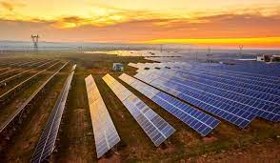
Solar Power
Widely used today
Can be used as replacement
Many issues however

Slide 3
Forecast
Dispatchability
Monitor plant performance
Efficiency

Slide 4
Goal
Accurately predict solar generation forecast

Slide 5
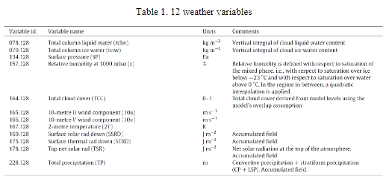
Dataset
Global Energy Forecasting Competition 2014, Australia
3 plants

Slide 6
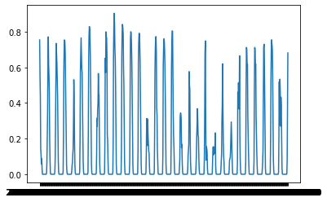
Dataset overview
April 2012

Slide 7
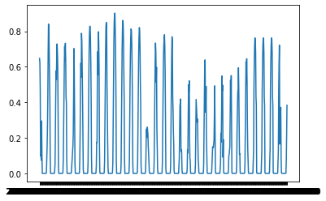
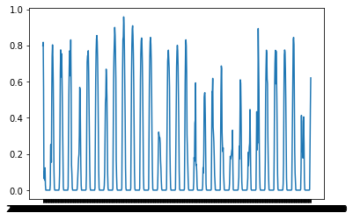
Comparing Plants

Slide 8
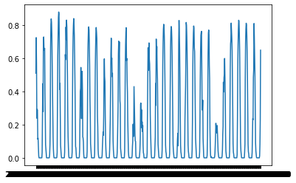
April vs November

Slide 9
Approach
Split
Split data set into training and testing
Split
Split it further into the 3 solar plants to avoid complexity
Analyze
Analyze the performance of several models
Pick
Pick the best model

Slide 10
Data Preprocessing
Convert and encode labels to multiclass
Dimensionality reduction

Slide 11
Model Choice
Neural Network
High Complexity train
Fast predictions
Non-linear
SVM
High Complexity train
Fast predictions
Non-linear

Slide 12
Model Choice
Random Forest
Medium Complexity train
Slow predictions
KNN
Insightful
Slow predictions
Easy to train

Slide 13
Results
ZONEID | 1 | 2 | 3
MAE | 347.49 | 390.74 | 424.28
RMSE | 689.63 | 693.53 | 798.56

Slide 14
Conclusion
Better model selection
Perhaps an ensemble
Better feature selection/reduction techniques

